Slide 1
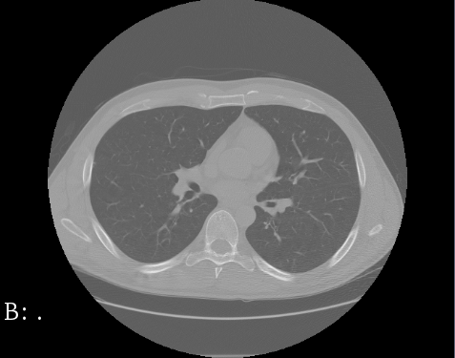
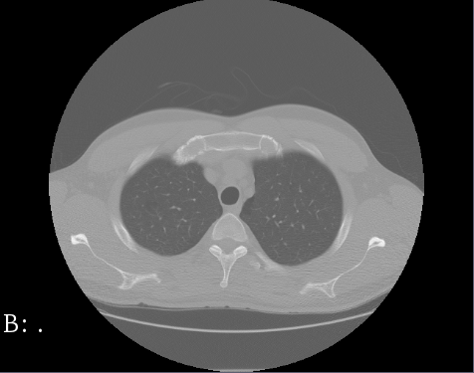
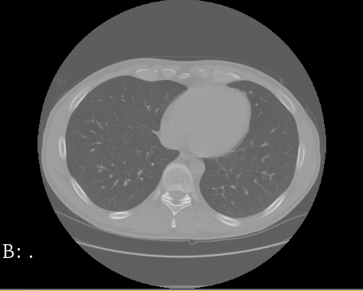
DeepMedic and U-Net neuronal network architectures
for lung segmentation in CT scans
Lionel Rajaona
Rajat Balbotra
Daniel Allen
Steffen Bleher

Slide 2
Outline
Lung segmentation and LUNA16 dataset
CNN architectures
U-Net
DeepMedic
Process and problems
Evaluation
Conclusion

Slide 3
1. Lung segmentation and LUNA16 dataset

Slide 4
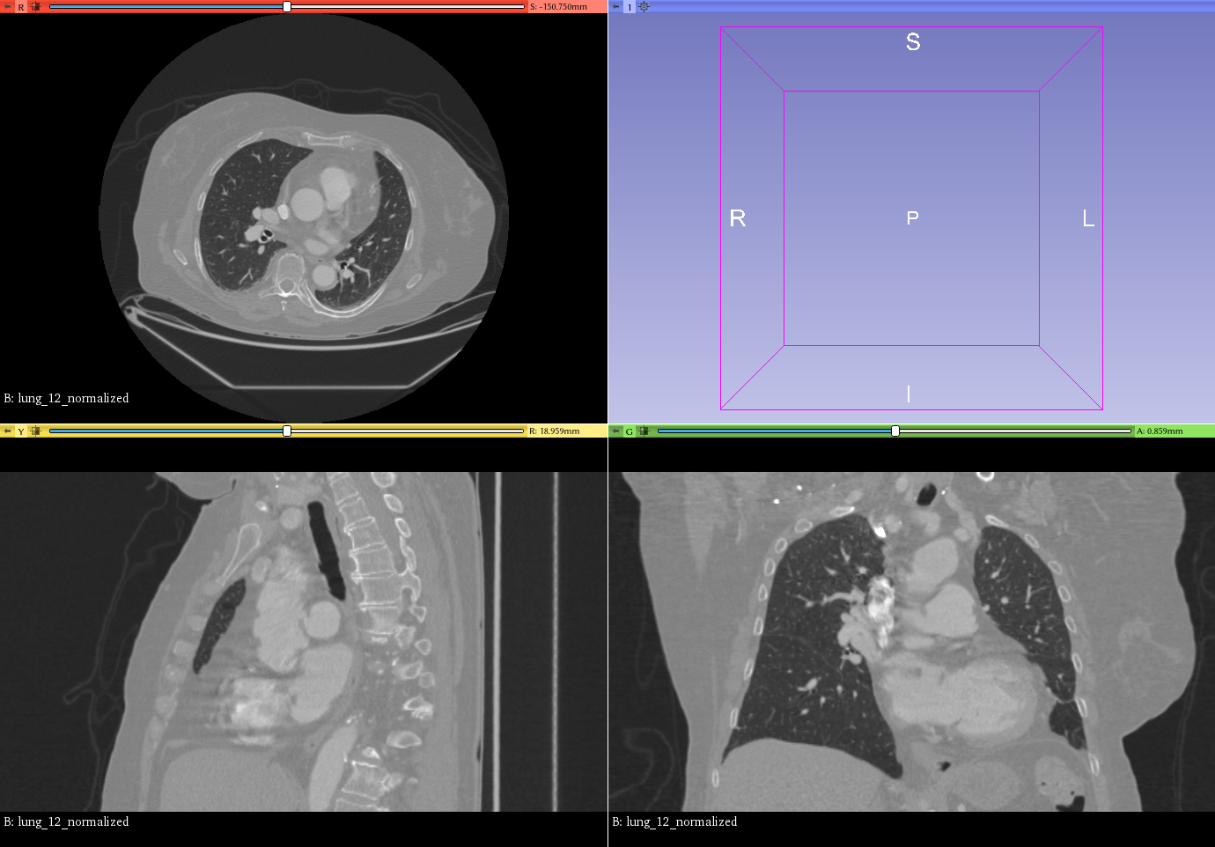
1. Lung segmentation and LUNA16 dataset
Medical Image Computation (MIC)
Image Segmentation
Computed Tomography (CT) slices
Notes:
A lot of image data in medical application, ml can help to deal with this data → MI

Slide 5
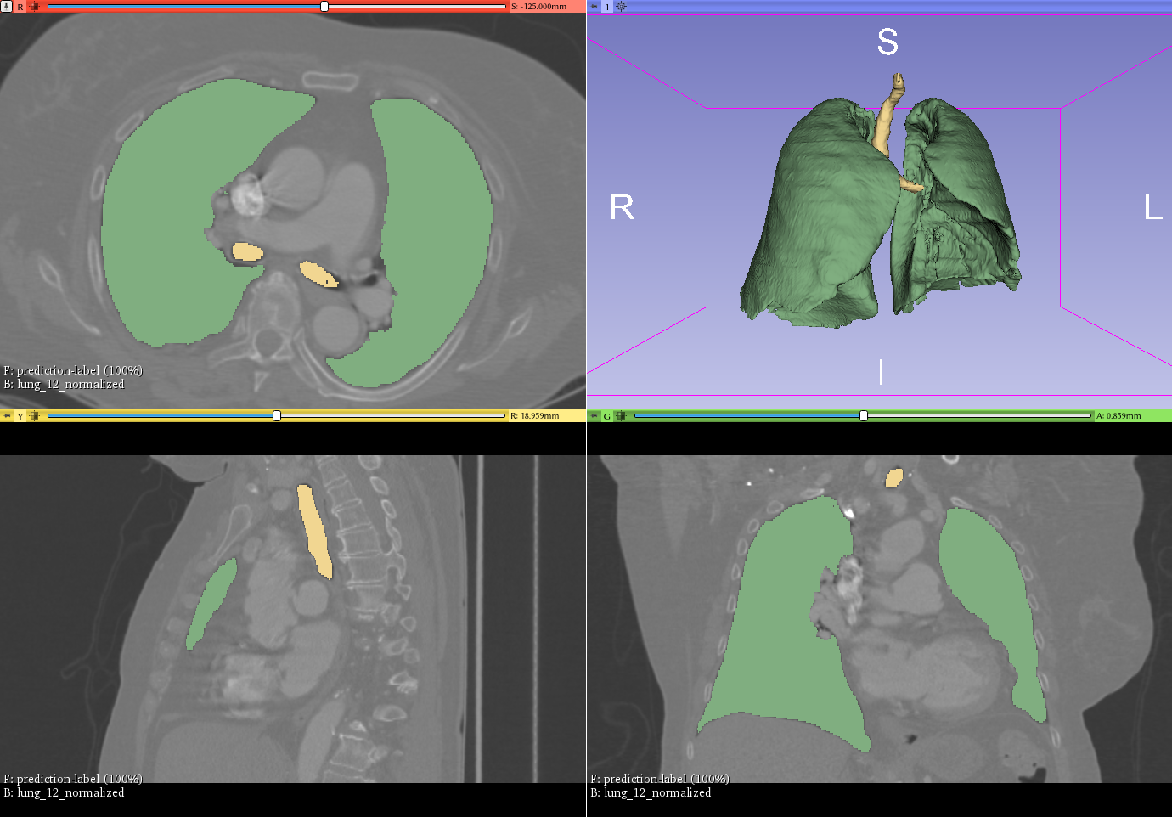
1. Lung segmentation and LUNA16 dataset
Medical Image Computation (MIC)
Image Segmentation
Computed Tomography (CT) slices
Extract a 3D structure of the lung
First step for cancer detection, …
Notes:
A lot of image data in medical application, ml can help to deal with this data → MIC

Slide 6
1. Lung segmentation and LUNA16 dataset
LUNA16 dataset
Slices of greyscale CT images
Slices of binary label maps
→ Train networks to create label maps
Notes:
A lot of image data in medical application, ml can help to deal with this data → MIC

Slide 7
2. Convolutional neural network architectures

Slide 8
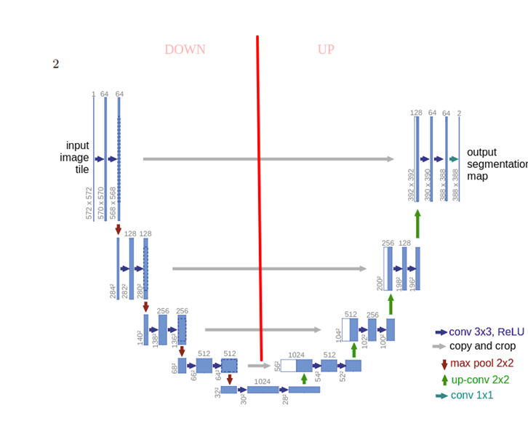
1. CNN architectures – U-Net
Fully convolution network used for biomedical image segmentation.
Concatenates the higher resolution features from down sampling part.

Slide 9
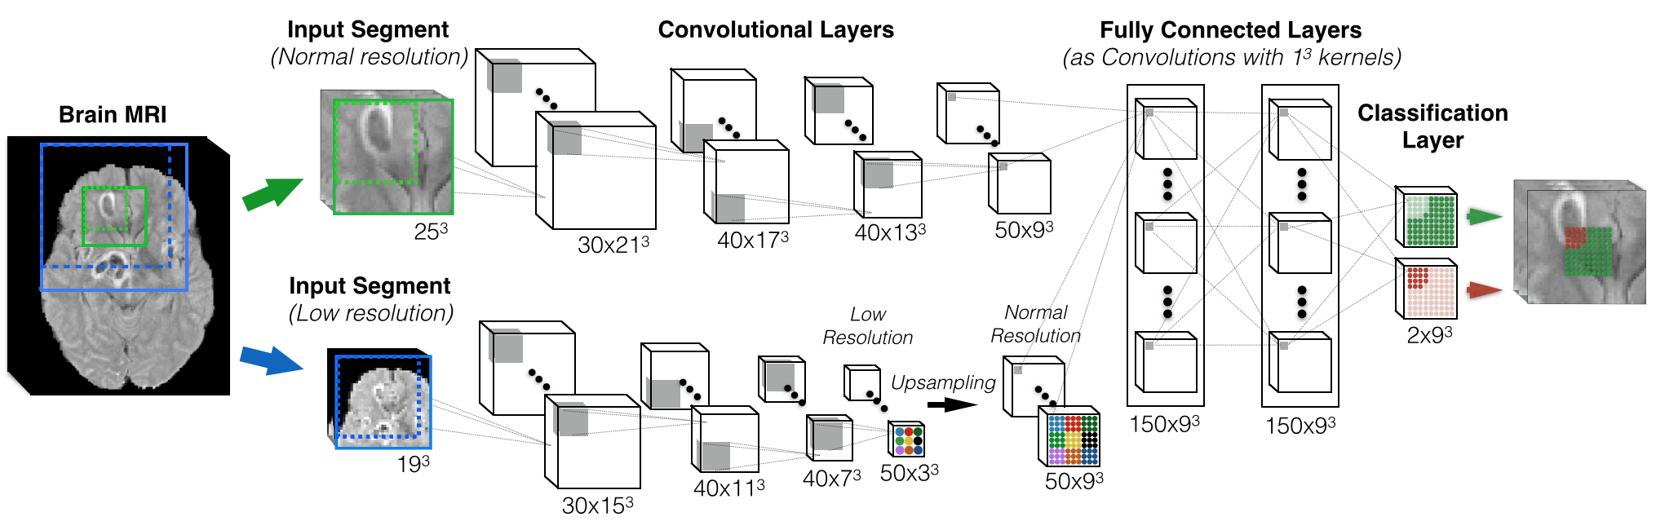
2. CNN architectures – DeepMedic
3D convolutional neural network
Initially designed for brain tumors
Detect particular patterns in a 3D image

Slide 10
3. Process and problems

Slide 11
3. Process and problems
Preprocessing
Training and Validation
↯ Issues with big dataset
↯ Recognition of different labels

Slide 12
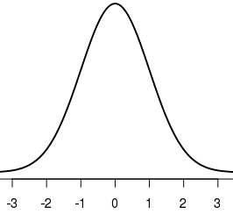
3. Process and problems
Preprocessing
Manual check of dataset
Normalization: μ = 0 and σ = 1 (ITK library)

Slide 13




3. Process and problems
Training
Setup
DeepMedic -> configuration of an open-source code
U-net -> own implementation
Trained on Nvidia GTX1080Ti

Slide 14
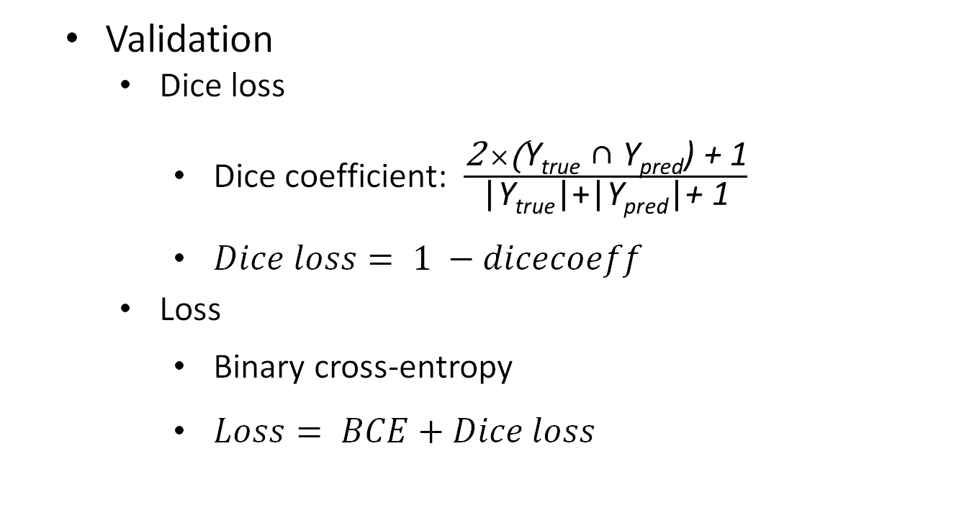
3. Process and problems
Validation
Dice loss
Dice coefficient: $\frac{\text{2} ×\text{(}\text{Y}\text{true}\text{ ∩ }\text{Y}\text{pred}\text{) }\text{+ 1}}{\text{|}\text{Y}\text{true}\text{|+}\text{|}\text{Y}\text{pred}\text{|}\text{+ 1}}$
$Dice loss= 1 −dicecoeff$
Loss
Binary cross-entropy
$Loss= BCE+Dice loss$
Notes:
Smooth factor 1: so that the dice coeff always exist even if there is no label value
Num: number of common labels
Denom: number of label values
Dice coefficient: measure how similar are two sets of label values Metric function, dice loss function, is easier to manipulate, as we need to minimize it.
We also use for our model a loss function

Slide 15
3. Process and problems
↯ Issues with big dataset
Providing images as a matrix with size [512, 512, number of slices]
Generation of dataset in real-time and feeding it right away to the training process Keras DataGenerator

Slide 16
3. Process and problems
↯ Issues with big dataset
Providing images as a matrix with size [512, 512, number of slices]
↯ RAM problem
→ Loading file in batches (real time)

Slide 17
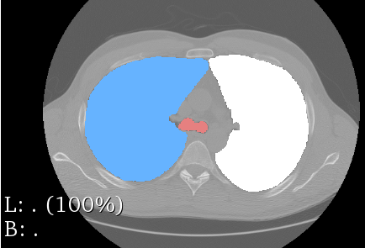
3. Process and problems
↯ Recognition of different labels
Most semantic segmentation network architectures not suitable for recognizing positional information
➔

Slide 18
4. Evaluation

Slide 19
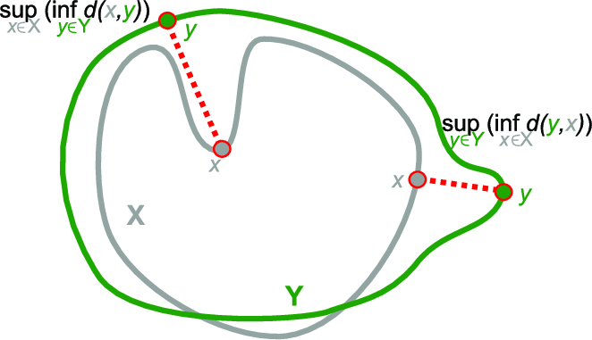
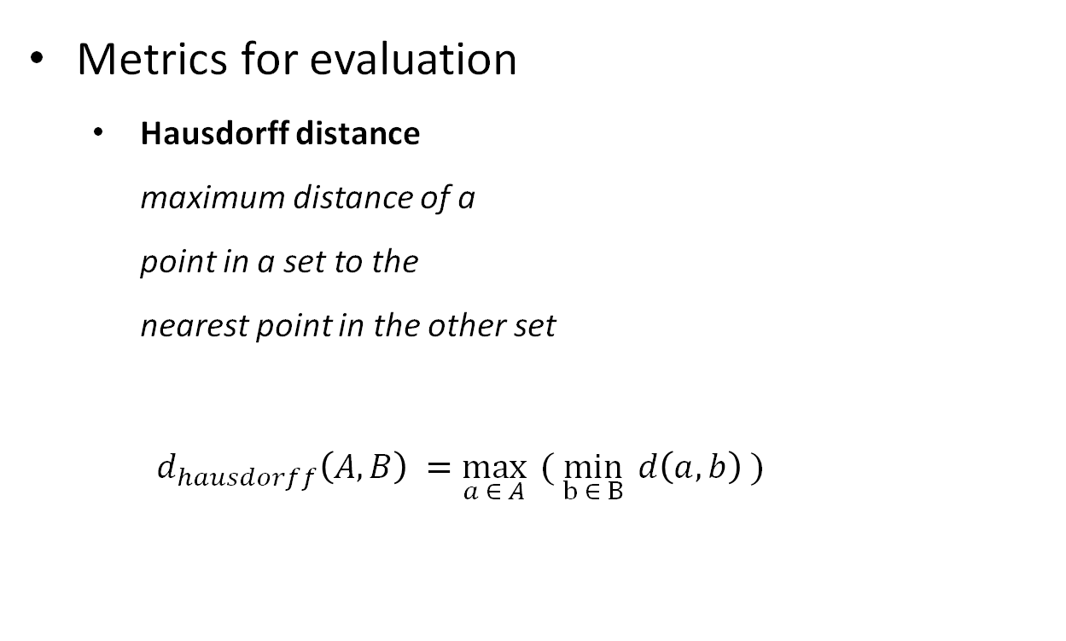
4. Evaluation
Metrics for evaluation
Hausdorff distance maximum distance of a point in a set to the nearest point in the other set
$d_{hausdorff}\left(A,B\right) =\max_{a ∈ A}{ ( \min_{b ∈ B}{d\left(a,b\right) )}}$
Notes:
Kind of maximum deviation to the label

Slide 20
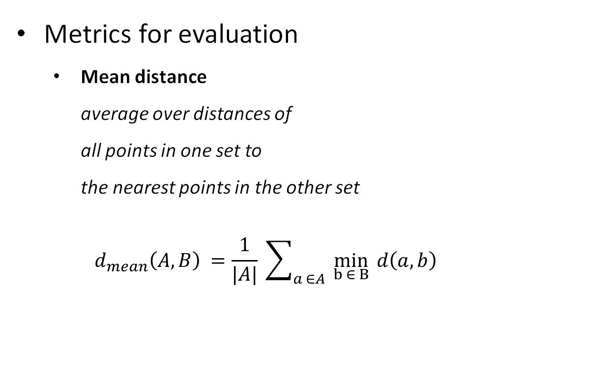
4. Evaluation
Metrics for evaluation
Mean distance average over distances of all points in one set to the nearest points in the other set $d_{mean}\left(A,B\right) =\underset{}{\frac{1}{|A|} \sum_{a ∈A}{ \min_{b ∈ B}{d\left(a,b\right) }}}{}$

Slide 21
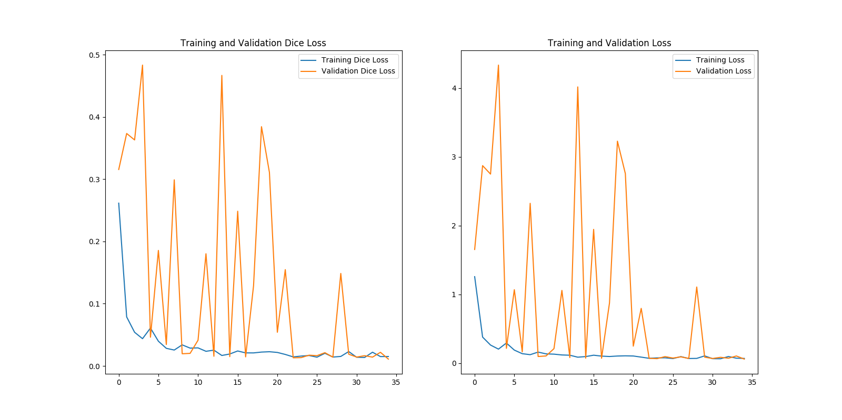
4. Evaluation
Training process of U-Net
Dice Loss BCE + Dice Loss

Slide 22
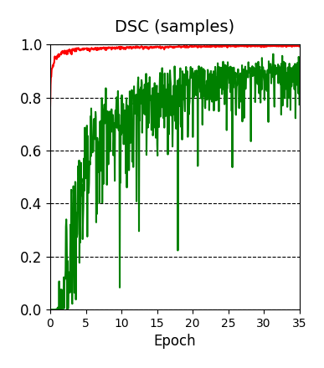
4. Evaluation
Training process of DeepMedic (Dice Loss)
--- Lungs
--- Bronchus

Slide 23
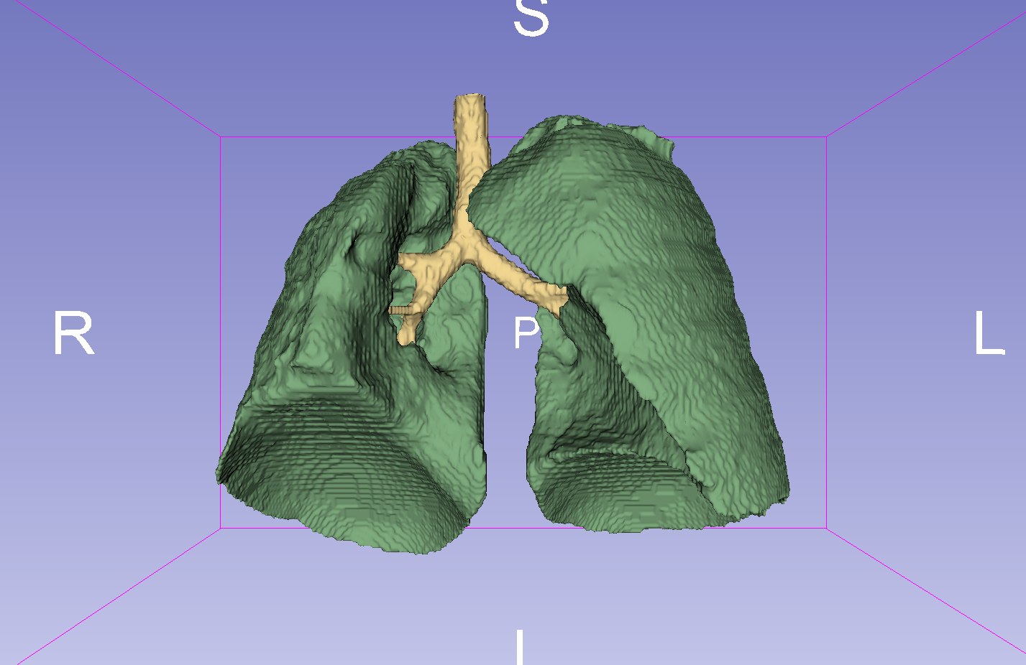
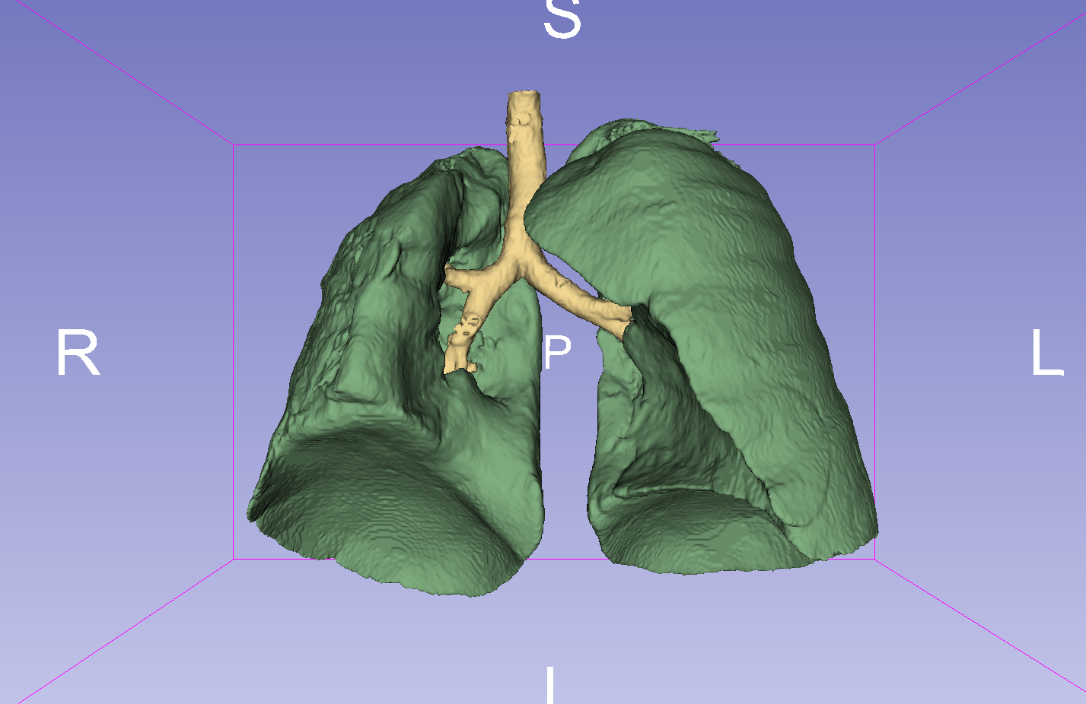
4. Evaluation
Prediction with DeepMedic
original
prediction

Slide 24
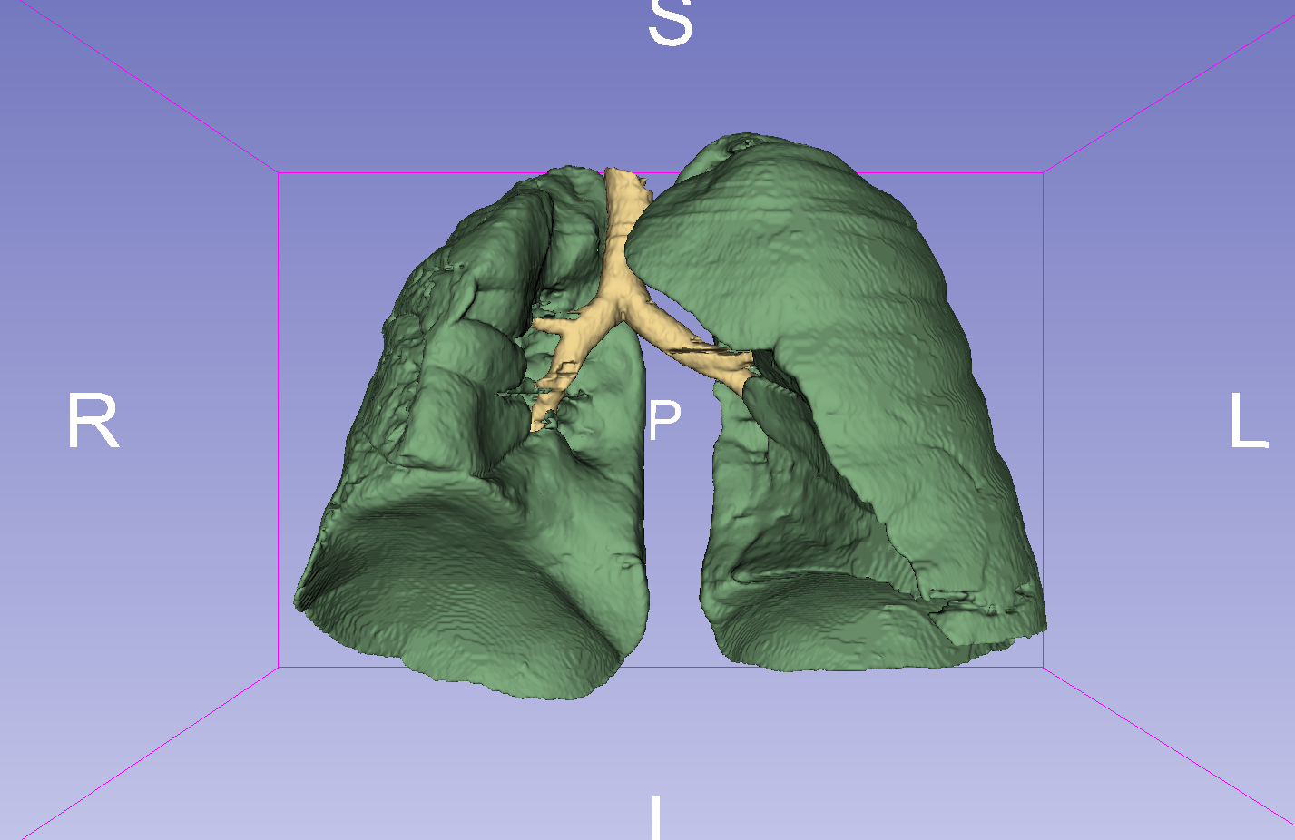
4. Evaluation
Prediction with U-net
original
prediction

Slide 25
4. Evaluation
Metrics on test set lungs (average over 20 images)
Architecture | Dice Coefficient | Hausdorff Distance (mm) | Mean Distance (mm)
DeepMedic | 0.968 | 119.50 | 1.45
U-Net | 0.976 | 103.21 | 0.33
Postprocessing of prediction could reduces Hausdorff distance by removing noise

Slide 26
5. Conclusion

Slide 27
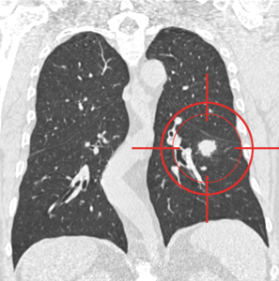
5. Conclusion
Biggest Issues for Data Analytics with Images:
Allocation of computational resources
Data preparation
Powerful networks available for this task
Next step:
Cancer detection by identifying nodules
Notes:
Detect ay abnormality in the lung, anithing which could warn a tumor

Slide 28
Thanks for the attention
Questions?

